Slide 1
Camden Sustainability Partnership Board
1st March 2011

Slide 2
Presentation
Cofely District Energy
Group Projects and Case Studies
Characteristics of Successful Projects
Questions & Answers

Slide 3
Cofely District Energy
Nationally – No.1 in District Energy
  ~ 35 MW of low carbon electricity generation
  Operation & management of over 300 MW of boiler plant and 50 km of district heating and cooling pipework
Manchester
  Alexandra Park & Longsight Estates
  Media City
London
  Olympic Park and Stratford City
  Bloomsbury Heat & Power
  Whitehall
  Comet Square, Hatfield
  Greenwich Millennium Village
West Midlands
  Birmingham District Energy Co
  Berryfields Estate
South Coast
  Southampton Geothermal Heating Co
  Eastleigh

Slide 4
CDE Capabilities
Over 20 years experience of district heating and CHP in the UK
Stable and directly employed operations teams
In house design and project management capability
  Design
  Build
  Finance
  Own
  Operate
  Maintain
Full risk outsourcing with a reliable and experienced partner

Slide 5
Group District Energy Projects
Case Studies and Lessons Learned

Slide 6
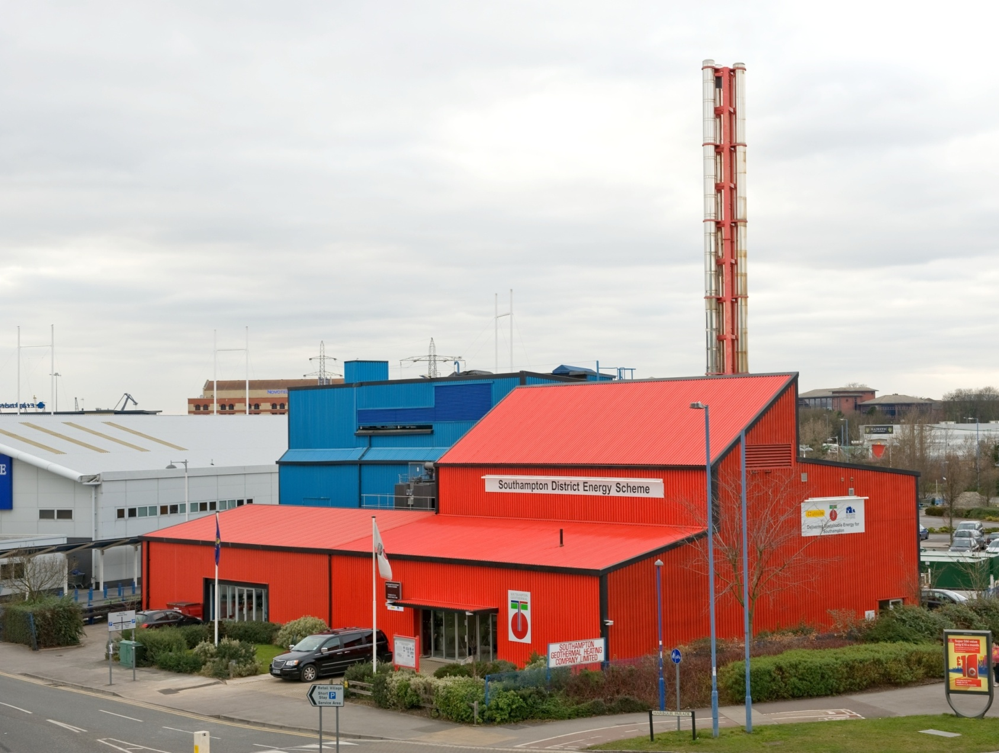
City Wide DE Scheme
70,000,000 kWh energy generated p.a.
11,000 tonnes CO2 saved p.a.
Providing heat chilled water & electricity to
45+commercial consumers
800+ residential consumers
Southampton Geothermal Heating Company, Southampton

Slide 7
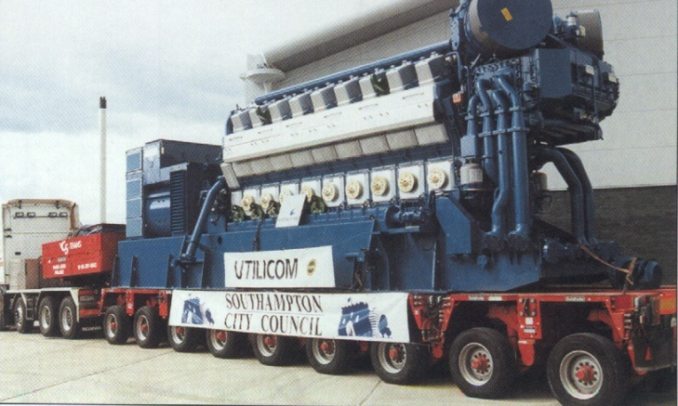
SGHC
Commenced 23 years ago
Built on a Joint Co-Operation Agreement with Southampton City Council
£5.0 M p.a. Energy Sales
£0.6 M p.a. cost savings to consumers.
11,000 tonnes of CO₂ saved p.a.
8MWe of CHP
UK’s only genuine deep geothermal resources
Supplying heating, cooling and electricity
A network of 14 km of buried pipework
Project built on 20 year energy supply contracts
Capital cost to date £12M

Slide 8
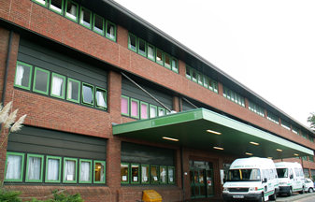
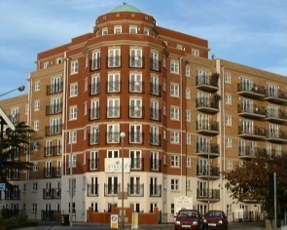
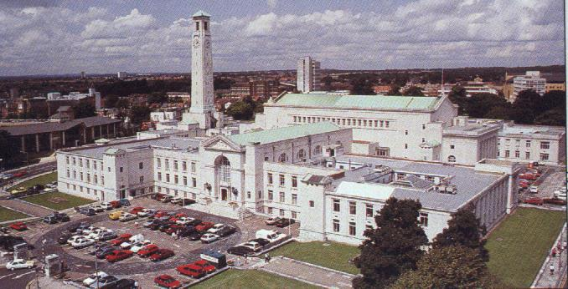

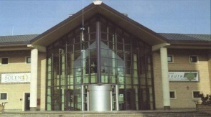
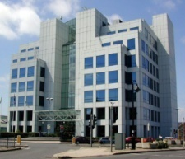
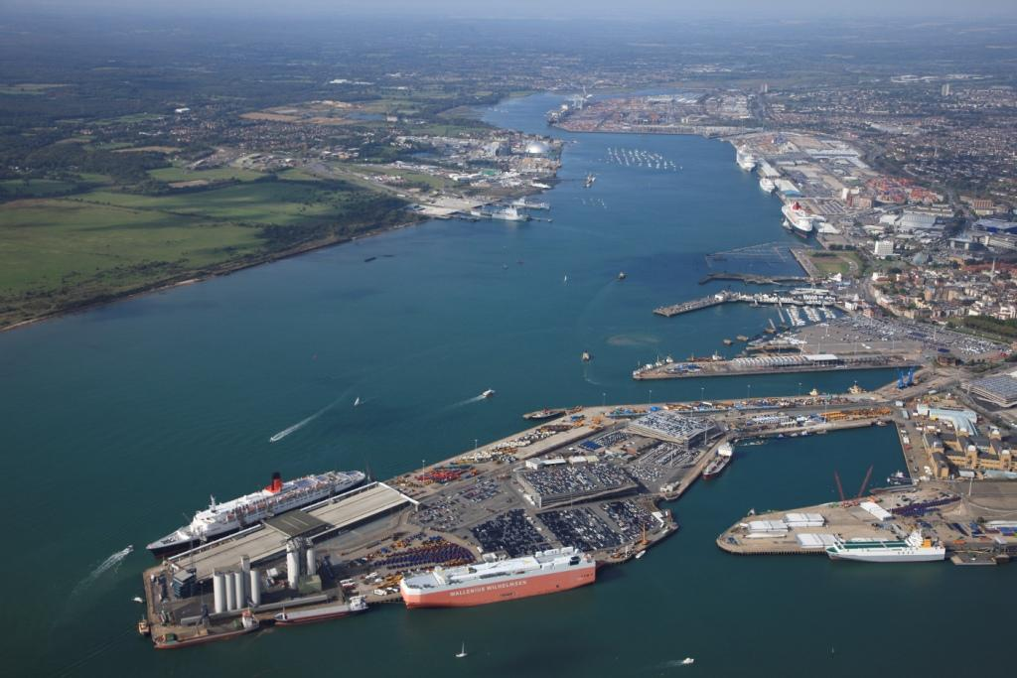

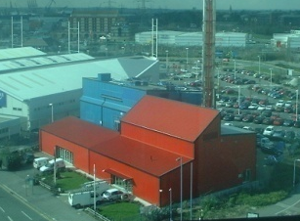
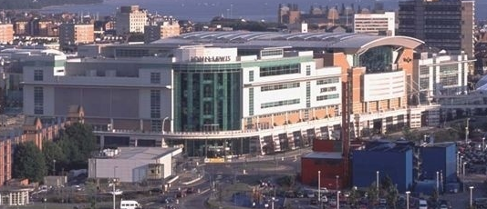
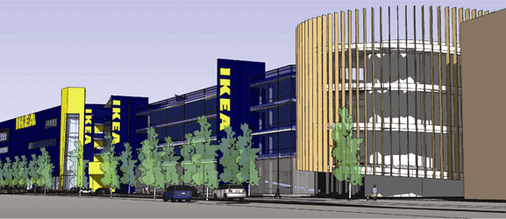
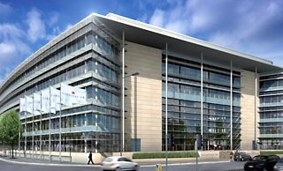
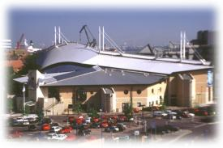
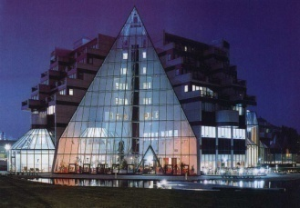

Parkview
Civic Centre
RSH
Hospital
Southampton Solent University
Energy Efficiency in Action
  Energy Efficiency in Action
    Energy Efficiency in Action
BBC TV Studio’s
ABP
Skandia Life
West Quay
The Heat Station
IKEA
DeVere
Hotel
Carnival
Quays

Slide 9
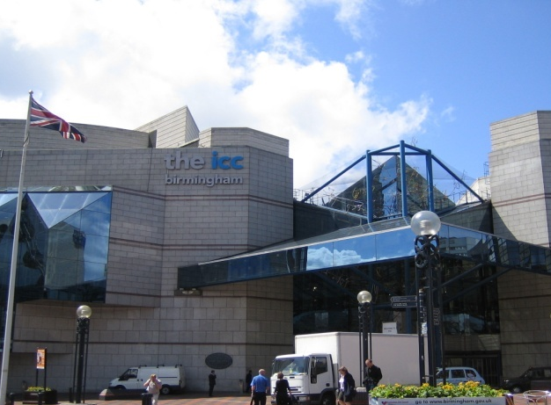
City Wide DE Scheme
12,000 tonnes CO2 saved p.a.
3 Core Partners
Providing heat chilled water & electricity from
3 Energy Centres
6.1MWe CHP
Birmingham District Energy Company, Birmingham

Slide 10
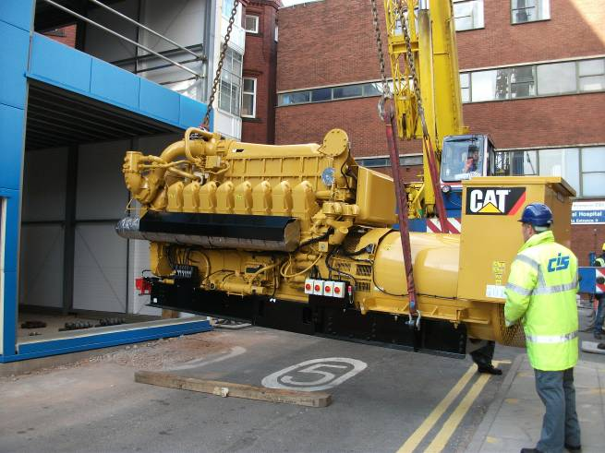
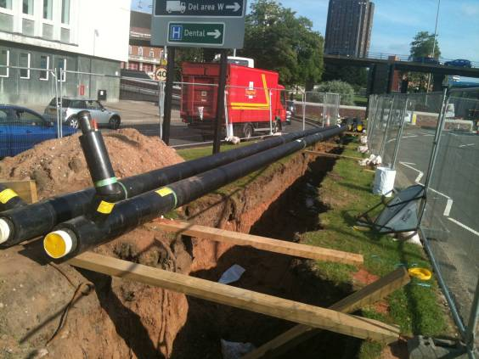
BDEC
Large commercially developed CHP/district energy scheme
Commenced 2006
3 Initial Schemes– City Centre, Aston University & Birmingham Children's Hospital
£6.0 M p.a. Energy Sales
£0.3 M p.a. cost savings to consumers.
12,000 tonnes of CO₂ saved p.a.
6.6 MWe of CHP
Supplying heating, cooling and electricity
Project built on 20 year energy supply contracts
Capital cost to date £7M

Slide 11
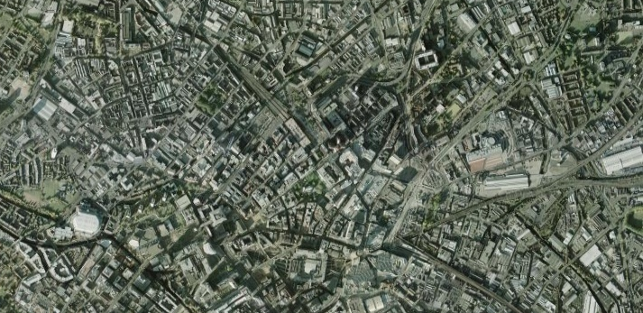
The Combined Schemes
Eastside Scheme
Phases 1 and 2
Energy Efficiency in Action
  Energy Efficiency in Action
    Energy Efficiency in Action
Broad Street Scheme
Broad Street Scheme
Eastside
Regeneration Area
Eastside
Regeneration Area
Westside Regeneration Area
Potential future energy links

Slide 12
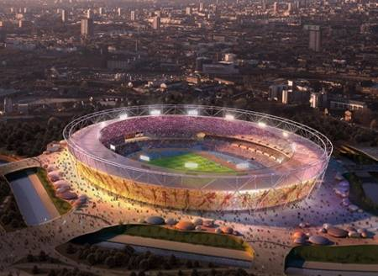
20 km of energy network
2 energy centres (district heating & cooling)
£100 million investment
40 year concession
Olympic Delivery Authority Energy Centres for London 2012

Slide 13

11 year contract
Operation & Maintenance of two energy centre plantrooms
Providing heat & standby power to
20 Government depts
Whitehall Distribution Centre, London

Slide 14
Characteristics of Successful Projects

Slide 15
The DE Triangle
Diversity
Density
Deliverability

Slide 16
Diversity
What does it mean?
  Mix of building types
  Usage at different times of day/year
  Usage for different loads - DHW; space heating; process heating
  Existing buildings – a function of the existing urban geography
  New Developments – mixed use is quite common for larger developments
Why is it important?
  CHP and other low carbon plant operates optimally at continuous output
  Diverse loads provides year round baseload
  Increases CO₂ savings and financial viability
  Can reduce peak demand significantly

Slide 17
Density
What does it mean?
  Heat density (kWh/m²)
  Proximity of buildings
Why is it important?
  Reduces capital cost due to reduced network costs
  Reduces highway buried services risk
  Increases financial viability

Slide 18
Deliverability
Several key issues including;
  Potential for long term contract
  Number of customers
  Nature of customers
  Revenue certainty and financability
  Timing (phasing of loads)
Key questions;
  Who would the contracting party be?
  How much of the project can they commit?
  Does this provide sufficient certainty around energy consumption, energy sales and appropriate plant selection?

Slide 19
Questions & Answers

